Slide 1
Investigating Multi-Agent LLM Architectures & Latent Space of Stable Diffusion Models
Nick Witten, Mohit Singh

Slide 2
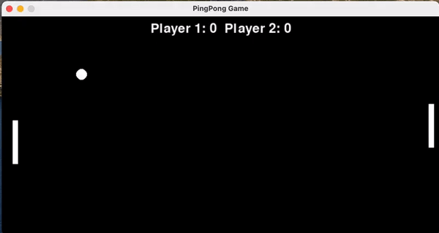
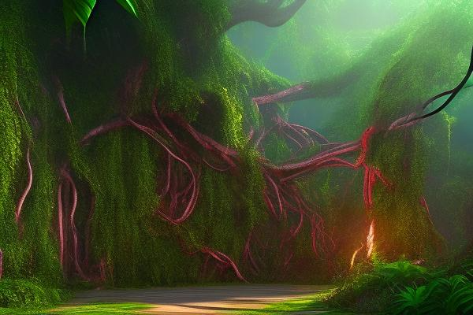
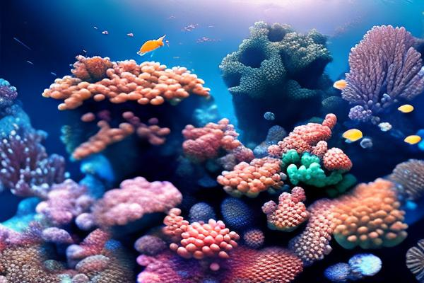
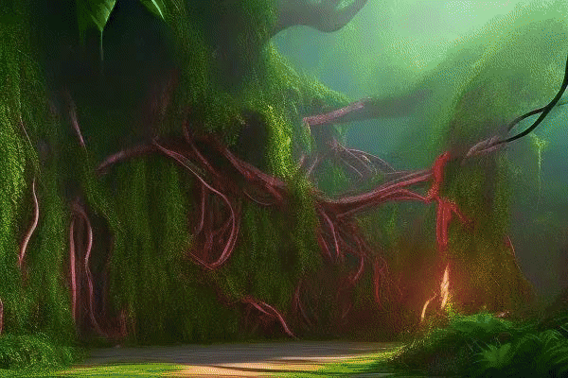
Motivation / Need
User Input
“Design a Ping Pong Game”
Automated Software Engineering
In the past few years, there has been great exploration into the idea of automating certain aspects of software development(automated testing, documentation)
In this presentation, we explore a multi-agent LLM architecture that automates all phases!
Image Fusion given 2 Text Prompts!!
Multi-Agent LLM (Designing, Coding, Testing, Documenting)
User Prompt 1
“Jungle w/ Vines. Majestic lighting.”
Stable Diffusion and Latent Interpolation
User Prompt 2
What if we combine both??
“Underwater coral reef. Hyper realism.”
Notes:
Would be cool to have a GIF here that shows two images being combined here

Slide 3
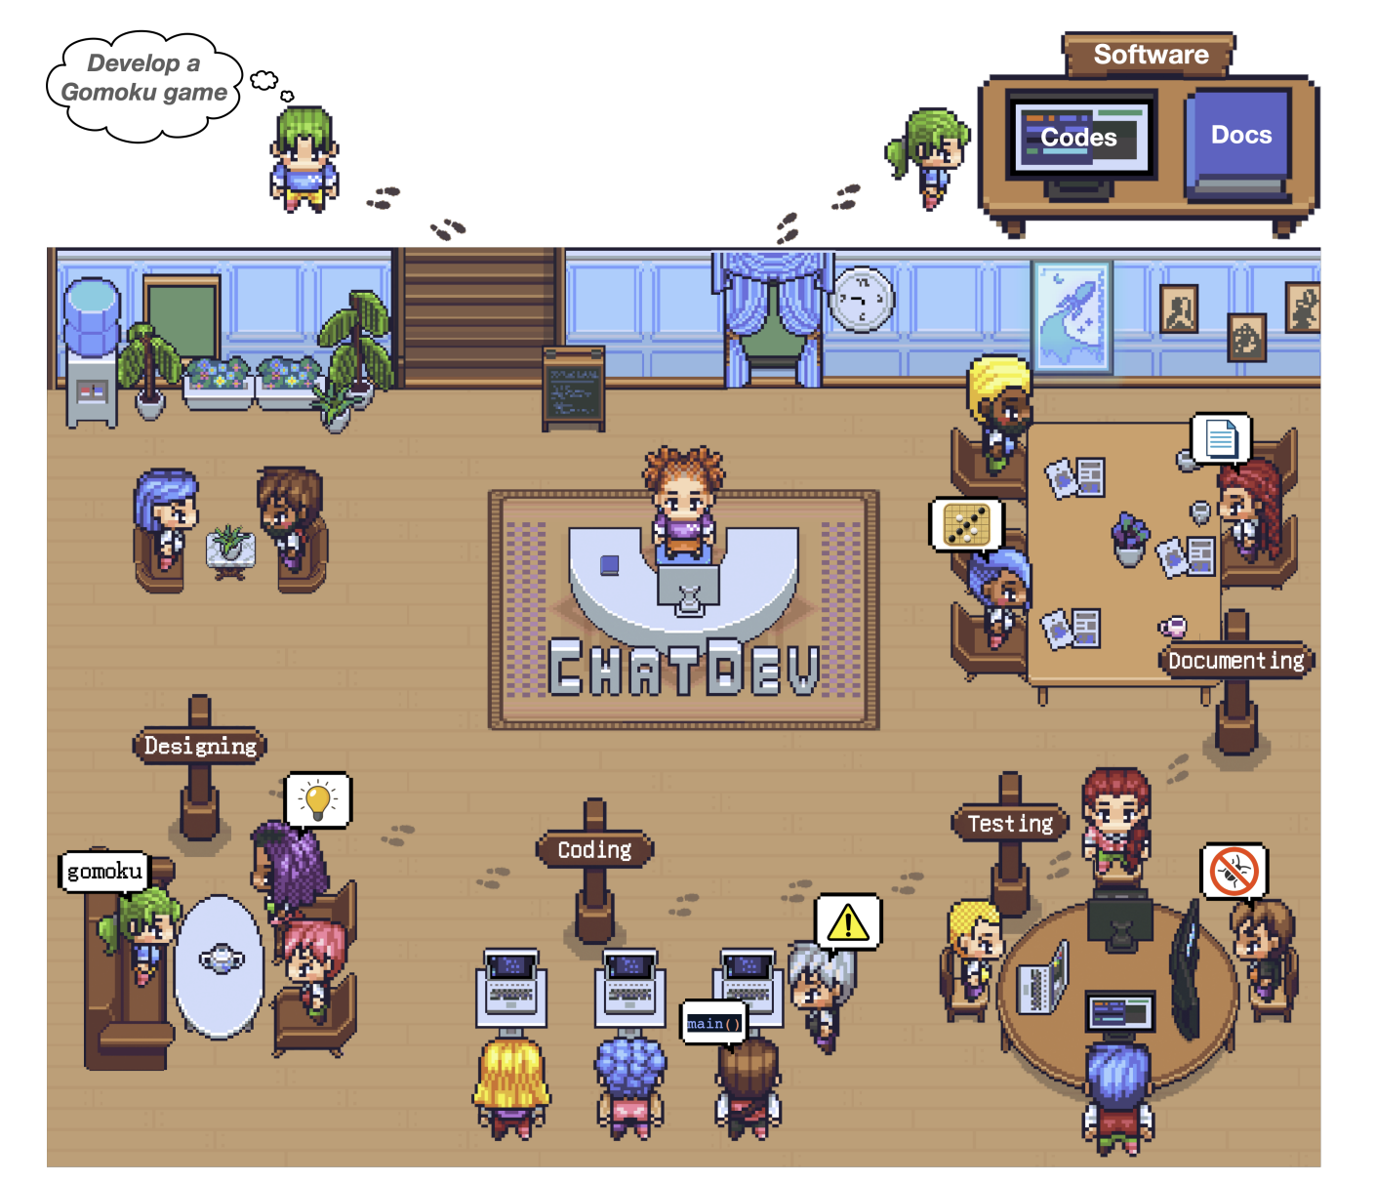
Project Objectives
Understand ChatDev, a multi-agent LLM architecture designed to mimic a software company with different company roles(CEO, CTO, Programmer, Reviewer/Tester, Art Designer)
Explore latent space of Stable Diffusion architecture
Integrate Stable Diffusion as an artist into ChatDev system and incorporate images into a software product output
Figure 1. Visualization of ChatDev Company [3]

Slide 4
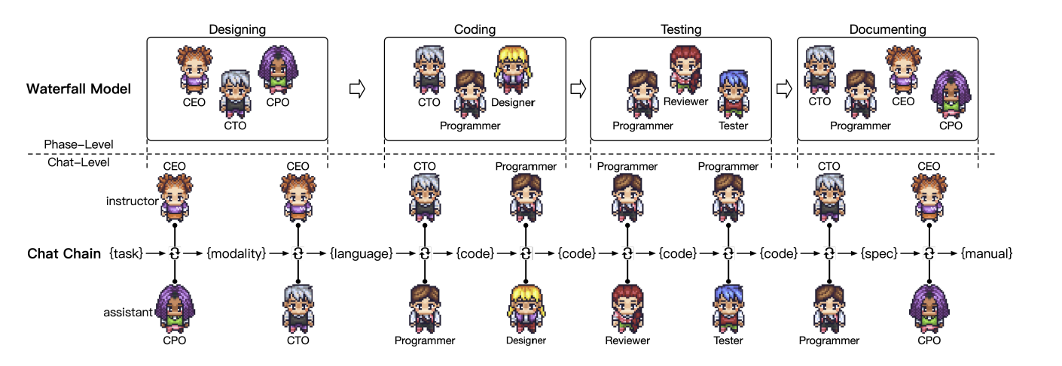
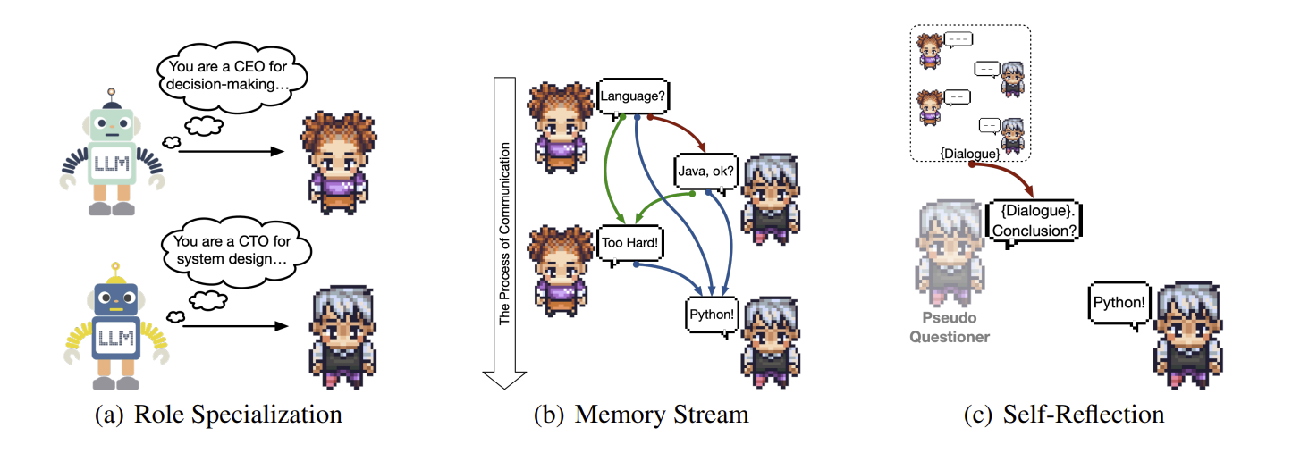
What is ChatDev?
Multi-agent LLM architecture designed to mimic software engineering company
Roles are assigned to each member of the company, which follow that of a standard company(CEO, CTO, Programmers, Designers, Reviewers, Testers). Each role is an LLM(ChatGPT3_5_TURBO)
Follows waterfall model for software engineering: designing, coding, testing, documenting
Communication between roles done via a “ChatChain”
Current ChatDev code outputs: Very impressive, but the GUIs are very standard and do not use images or videos.
We want to try adding a Diffusion-Art Designer role which will add images & videos generated by diffusion models!!
Figure 2. Default ChatChain in ChatDev [3]
Figure 3. Agent-Agent Communication Mechanisms
Notes:
Deep Learning-based methods to software engineering: require unique large scale training data that must be specialized for designing, coding, testing, and documenting individually, and they are very computationally intensive [3]
Multi-agent LLMs have shown to increase factual correctness and reasoning accuracy through role assignment and interaction [3]
Each phase of software development is broken down into individual atomic chats between two roles. The two roles engage in dialogue until a consensus is reached! The final output is passed onto the next group on the chain.Role specialization ensures that each agent fulfills their designated functions and contributes effectively to the task-oriented dialogue. The memory stream maintains a comprehensive record of previous dialogues within the chat, enabling agents to make informed decisions. Self-reflection prompts the assistant to reflect on proposed decisions when both parties reach a consensus without triggering predefined termination conditions.

Slide 5
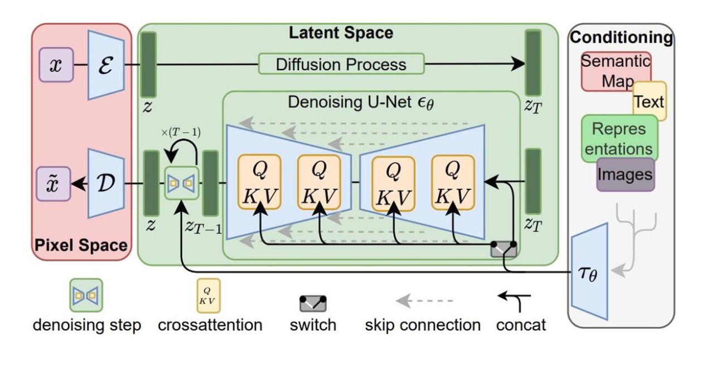
Stable Diffusion Architecture

Slide 6
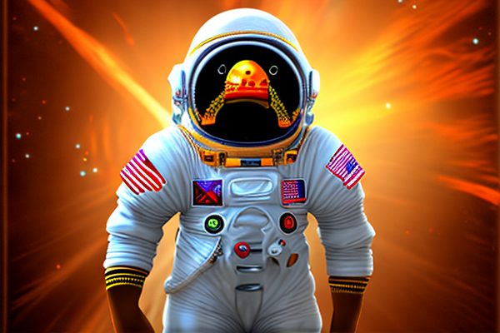
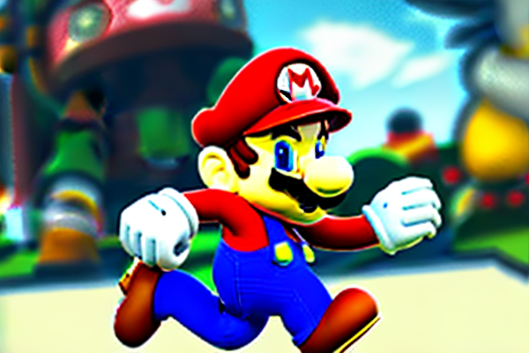
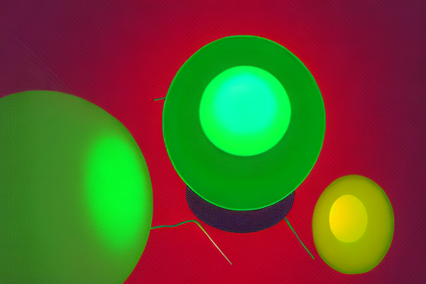
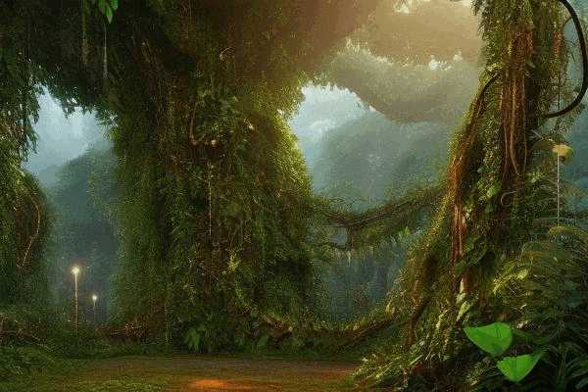
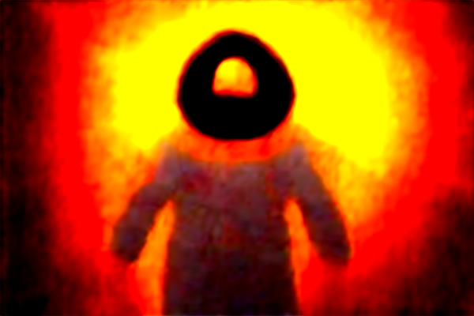
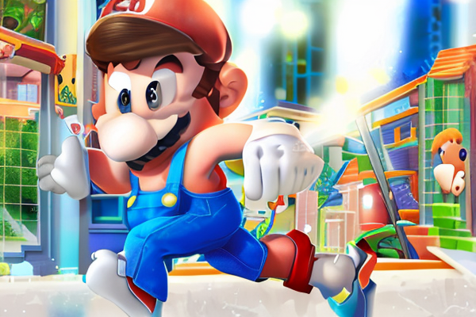
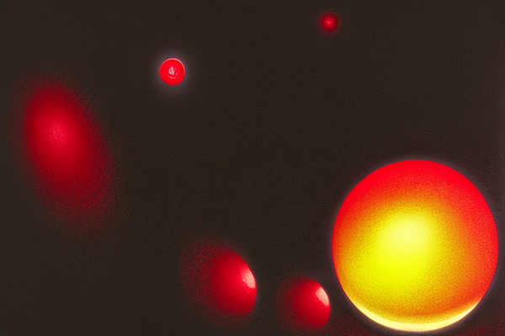
Latent Manipulation
Renoise (too few time steps) and denoise with new prompt
Renoise and denoise without guidance
Renoise and denoise with new prompt guidance
Linear interpolation in latent space using guidance from two prompts

Slide 7
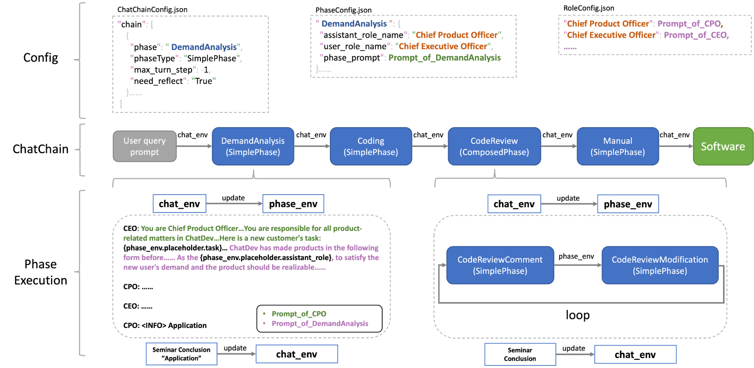
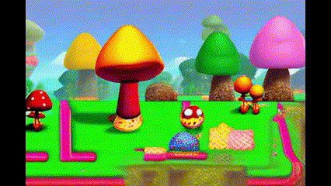
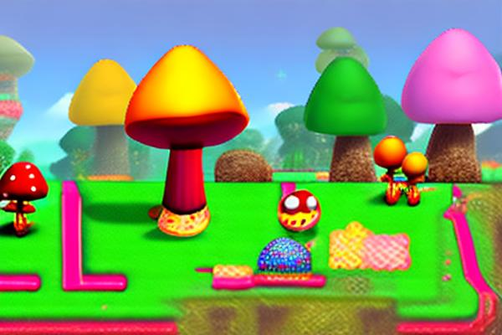
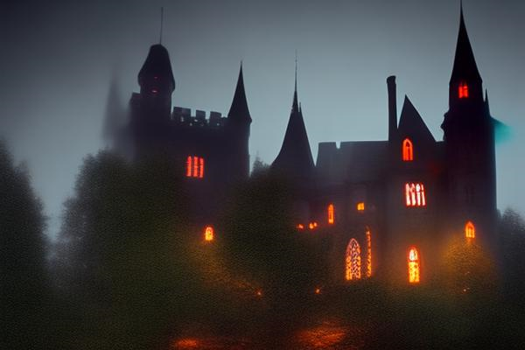
New ChatDev Architecture w/ DiffusionArt
User query prompt
“Make a simple Mario Game”
chat_env
DemandAnalysis
(SimplePhase)
chat_env
DiffusionArt (ComposedPhase)
chat_env
Coding
(SimplePhase)
chat_env
CodeReview
(ComposedPhase)
chat_env
Diffusion
Art Design
Diffusion
Art Integration
Software
Prompts for generating images (x2)
Fully implemented Mario Game in Python
Instructions for playing the game
Requirements.txt for downloading necessary packages
Incorporates Diffusion Art!
Stable Diffusion Pipeline

Slide 8

Mario Game Output w/ DiffusionArt

Slide 9
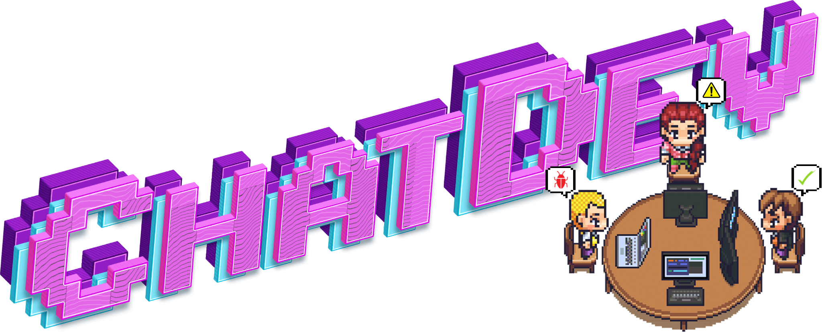
Conclusions / Future Work
Conclusions:
Made improvements to an existing multi-agent LLM model by incorporating a stable diffusion architecture with latent manipulation
Demonstrated the improved capability and visualizations of the improved architecture by creating a mario game from a single text prompt
Investigated techniques to manipulate latent vectors in a Stable Diffusion architecture for practical use.
Future Work
Conducting further analysis into the outputs possible with the new ChatDev Architecture
Trying software outputs other than video games, such as websites, media players, symbolic math calculators
Add new agents in the ChatDev Architecture for improved stability and expressibility
Create new methods for image manipulation
Learn VAE prior distribution for best log likelihood path in interpolation.

Slide 10
References
[1] https://arxiv.org/abs/1312.6114v11
[2] https://github.com/OpenBMB/ChatDev
[3] https://arxiv.org/abs/2307.07924
[4] https://github.com/huggingface/diffusers
[5] https://huggingface.co/prompthero/openjourney

